Slide 1

INTRODUCTION TO COMPUTER NETWORKS
Navpreet Singh
Computer Centre
Indian Institute of Technology Kanpur
Kanpur INDIA
(Ph : 2597371, Email : navi@iitk.ac.in)

Slide 2
About Myself
About Myself
I am Network Manager at IIT Kanpur and I manage the Campus Network and Internet Services of IITK.
IIT Kanpur has one of the largest networks in the country.
IITK Campus Network now has 6500 nodes providing connectivity to more than 5000 users in Academic Departments, Student Hostels and Residences.
IITK has 45 Mbps Internet Connectivity.
All application servers (Mail, DNS, Proxy Caching, Web etc.) are maintained in-house.
B.Tech (1990) and M.Tech (1996) from IIT Kanpur
Working in IIT Kanpur for more than 14 years

Slide 3
Course Content
Course Content
Lecture 1: Overview of the Course and Network Fundamentals: 2 Hour
Lecture 2: OSI Model& TCP/IP Model : 2 Hour
Lecture 3: Physical Media (Copper, Fiber Optic and Wireless) : 2 Hour
Lab 1: IIT Kanpur Datacenter Visit: 2 Hour
Lecture 4: UTP & Fiber Cabling: 2 Hour
Lecture 5: LAN Technologies (Ethernet, Fast Ethernet, Gigabit Ethernet, Wireless LAN) : 2 Hour
Lab 2: Demo and Practice of UTP & Fiber Cabling: 2 Hour
Lecture 6: LAN Technologies (contd.) : 2 Hour

Slide 4
Course Content
Course Content
Lecture 7: WAN Technologies (Dialup, Leased Line, ISDN, ADSL, Cable Modem, VSAT) : 2 Hour
Lab 3: Demo and Practice of Ethernet & Wireless LAN Setup : 2 Hour
Lecture 8: WAN Technologies (contd.) : 2 Hour
Lecture 9: Internet Protocol (IP) and IP Addressing: 2 Hour
Lab 4: Demo and Practice of Setting up Subnets and IP Address Assignment : 2 Hour
Lecture 10: Routing, VLAN, TCP and UDP: 2 Hour
Lecture 11: SNMP, Natting, Firewall and VPN: 2 Hour
Lecture 12: Internet and Internet Applications (DNS, Email, Web..): 2 Hour

Slide 5
Course Content
Course Content
Lecture 13: Cisco Basics: 2 Hour
Lecture 14: Cisco Switch and Router Configuration : 2 Hour
Lab 5: Demo and Practice of Cisco Switch Configuration : 2 Hour
Lab 6: Demo and Practice of Cisco Router Configuration : 2 Hour
Lecture 15: DNS & Web Server Setup on Linux : 2 Hour
Lab 7: Demo and Practice of DNS and Web Server Setup : 2 Hour
Lecture 16: Enterprise Network Implementation: 2 Hour

Slide 6
Course Content
Course Content
Lecture 17: Mail Server, Proxy Server & Firewall Setup on Linux : 2 Hour
Lab 8: Demo and Practice of Mail Server , Proxy Server and Firewall Setup : 2 Hour

Slide 7
References
Books
Andrew S. Tanenbaum, Computer Network, Prentice-Hall
Doughlas E. Comer, Computer Networks and Internet
http://www.cisco.com/public/support/tac/documentation.html
http://www.redhat.com/docs
http://home.iitk.ac.in/~navi/sidbinetworkcourse

Slide 8
Grading Guidelines
Grading
Two Exams: 40% each
Lab Assignments: 20%
Minimum 80% attendance and minimum 60% marks are necessary to clear the course.

Slide 9
Introduction to Computer Networks
Introduction to Computer Networks
INTRODUCTION TO COMPUTER NETWORKS

Slide 10
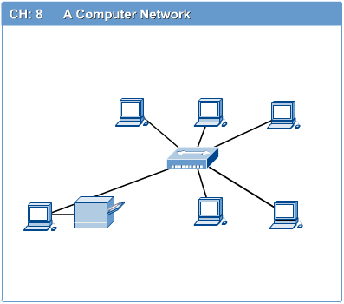
Computer Networks
Introduction to Computer Networks
Computer network connects two or more autonomous computers.
The computers can be geographically located anywhere.

Slide 11
LAN, MAN & WAN
Introduction to Computer Networks
Network in small geographical Area (Room, Building or a Campus) is called LAN (Local Area Network)
Network in a City is call MAN (Metropolitan Area Network)
Network spread geographically (Country or across Globe) is called WAN (Wide Area Network)

Slide 12
Applications of Networks
Introduction to Computer Networks
Resource Sharing
Hardware (computing resources, disks, printers)
Software (application software)
Information Sharing
Easy accessibility from anywhere (files, databases)
Search Capability (WWW)
Communication
Email
Message broadcast
Remote computing
Distributed processing (GRID Computing)

Slide 13
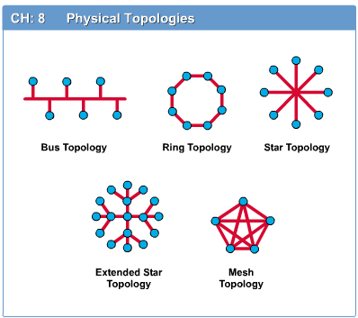
Network Topology
Introduction to Computer Networks
The network topology defines the way in which computers, printers, and other devices are connected. A network topology describes the layout of the wire and devices as well as the paths used by data transmissions.

Slide 14
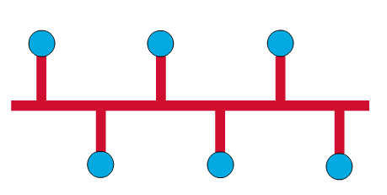
Bus Topology
Introduction to Computer Networks
Commonly referred to as a linear bus, all the devices on a bus topology are connected by one single cable.

Slide 15
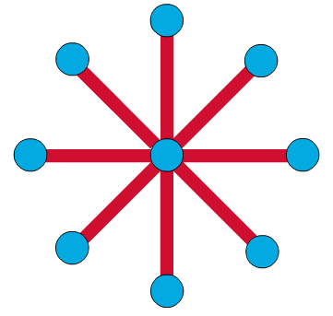
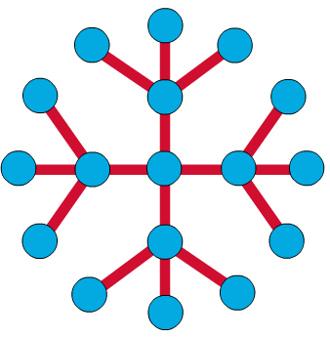
Star & Tree Topology
Introduction to Computer Networks
The star topology is the most commonly used architecture in Ethernet LANs.
When installed, the star topology resembles spokes in a bicycle wheel.
Larger networks use the extended star topology also called tree topology. When used with network devices that filter frames or packets, like bridges, switches, and routers, this topology significantly reduces the traffic on the wires by sending packets only to the wires of the destination host.

Slide 16
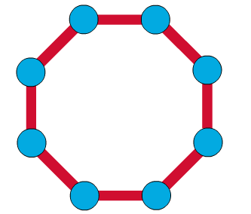
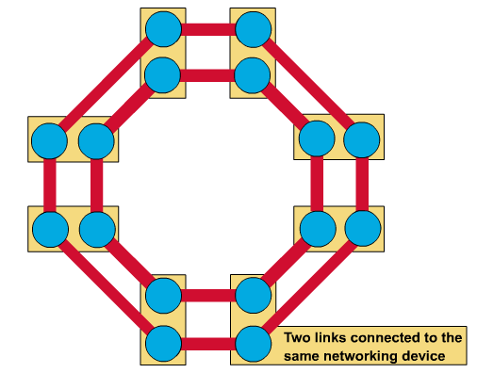
Ring Topology
Introduction to Computer Networks
A frame travels around the ring, stopping at each node. If a node wants to transmit data, it adds the data as well as the destination address to the frame.
The frame then continues around the ring until it finds the destination node, which takes the data out of the frame.
Single ring – All the devices on the network share a single cable
Dual ring – The dual ring topology allows data to be sent in both directions.

Slide 17
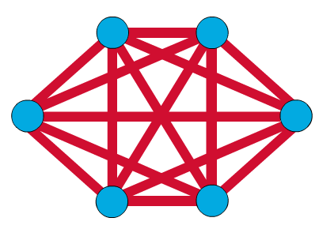
Mesh Topology
Introduction to Computer Networks
The mesh topology connects all devices (nodes) to each other for redundancy and fault tolerance.
It is used in WANs to interconnect LANs and for mission critical networks like those used by banks and financial institutions.
Implementing the mesh topology is expensive and difficult.

Slide 18
Network Components
Introduction to Computer Networks
Physical Media
Interconnecting Devices
Computers
Networking Software
Applications

Slide 19
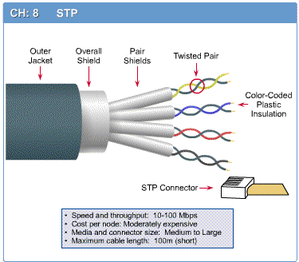
Networking Media
Introduction to Computer Networks
Networking media can be defined simply as the means by which signals (data) are sent from one computer to another (either by cable or wireless means).

Slide 20
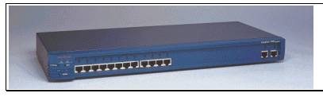
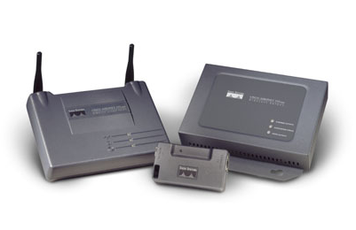
Networking Devices
Introduction to Computer Networks
HUB, Switches, Routers, Wireless Access Points, Modems etc.

Slide 21
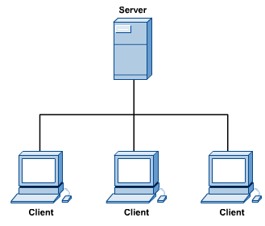
Computers: Clients and Servers
Introduction to Computer Networks
In a client/server network arrangement, network services are located in a dedicated computer whose only function is to respond to the requests of clients.
The server contains the file, print, application, security, and other services in a central computer that is continuously available to respond to client requests.

Slide 22
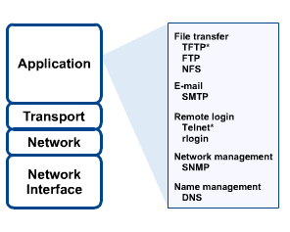
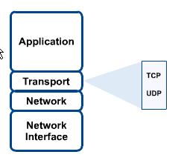
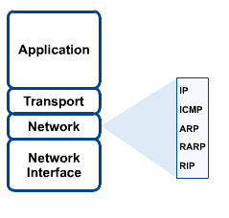
Networking Protocol: TCP/IP
Introduction to Computer Networks

Slide 23

Applications
Introduction to Computer Networks
E-mail
Searchable Data (Web Sites)
E-Commerce
News Groups
Internet Telephony (VoIP)
Video Conferencing
Chat Groups
Instant Messengers
Internet Radio

